Slide 1
Data analysis on air quality of Indian city
presented by: under the Guidance of:
Rishabh Ranjan (181046024) Deepak Rao
rohan raj rao (181046030) asst. prof (sois)
Bigdata and data Analysis(I sem)
Sois, mahe

Slide 2
What did we do before? phase 1
Why this Project?
What is AQI? Why AQI in India?
Where did we collect data from?
What did we do with data?
What next?

Slide 3
What did we do now? phase ii
Constant Literature Survey
Interquartile Range
Machine Learning Analysis
Statistical Analysis
Interactive Visualization

Slide 4
Week 1
Synopsis
Data Collection
Week 2
Literature Survey
Data Cleaning
Week 3
AQI Prediction Literature Survey
Data Cleaning
Year-Zone wise
Week 4
Week 5
Week 6
Week 7
Mid Project Review
Data Visualization for Dataset
Literature Survey for ML Algorithms
Different ML Algorithms
AQI Calculation
ML Models
Literature Survey
KNN Model
Statistical Models
Logistic Regression
ARIMA Model
Range Slider
Inter-quantile plots
Final Review
Project Timeline from 1st September to 2nd November

Slide 5
box plot

Slide 6
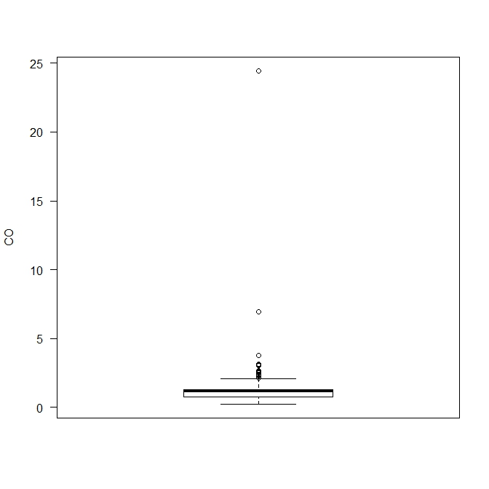
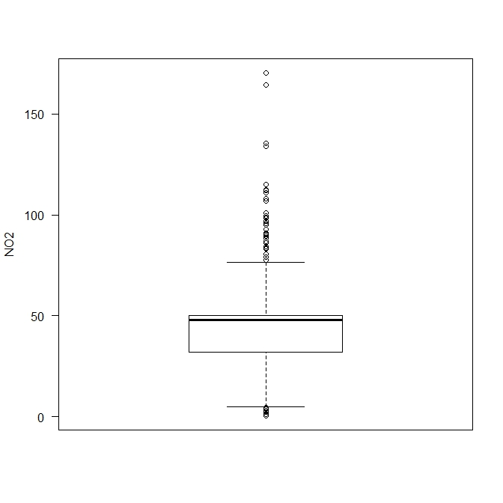

Slide 7
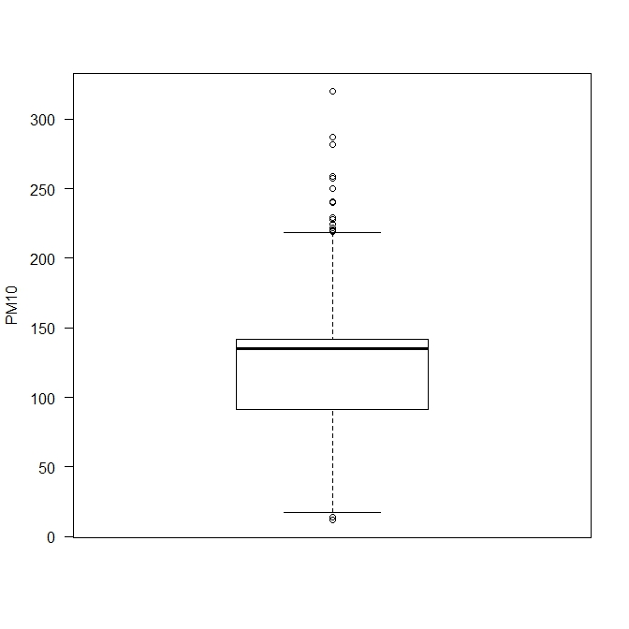
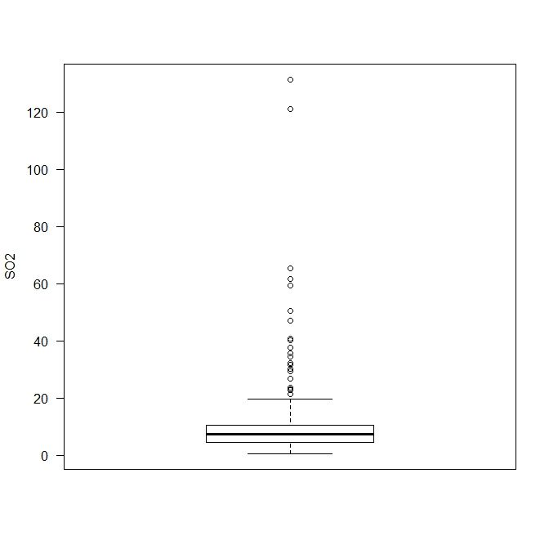

Slide 8
Machine learning analysis
k-Nearest Neighbour
Logistic Regression

Slide 9
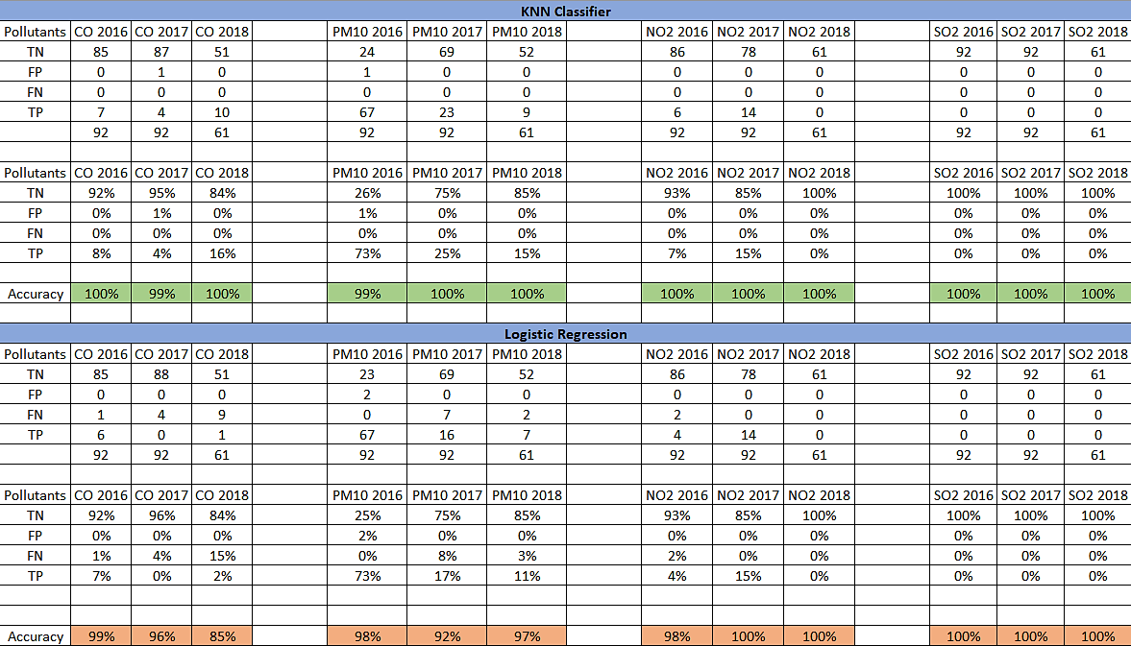

Slide 10
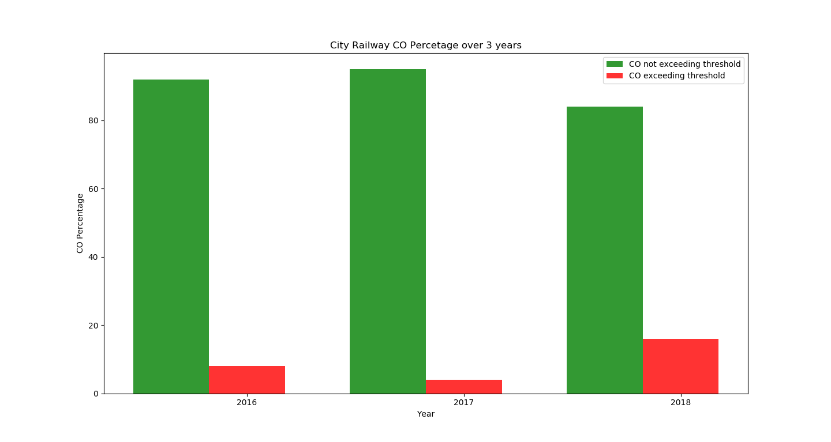
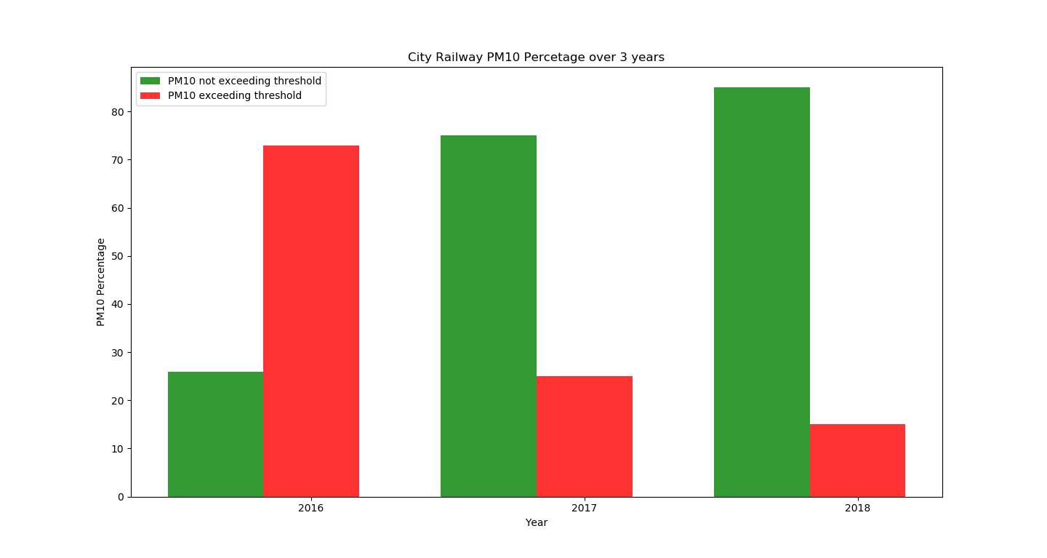
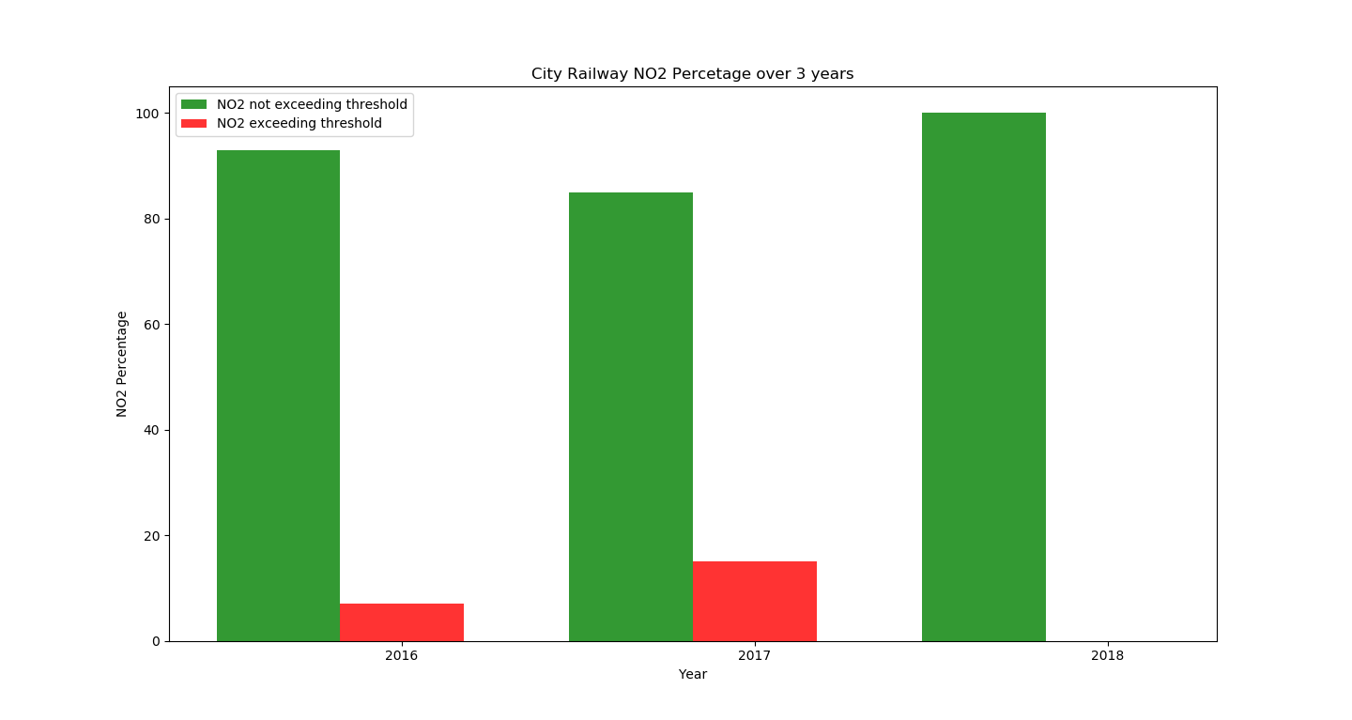
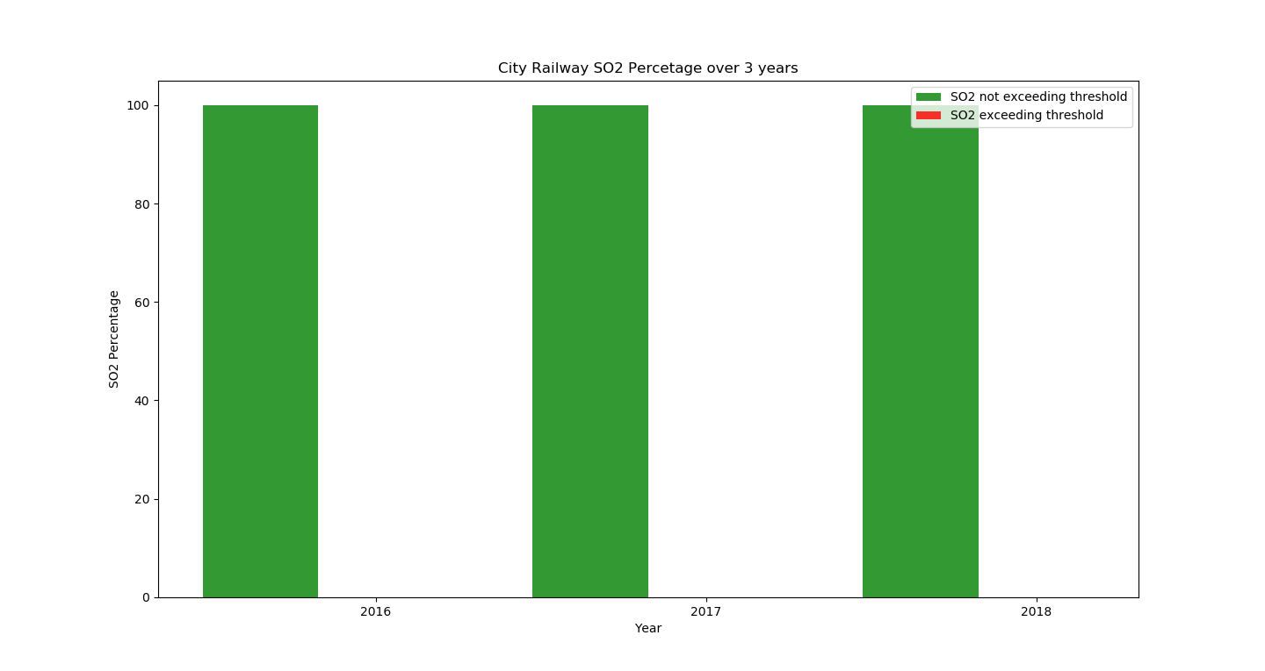

Slide 11
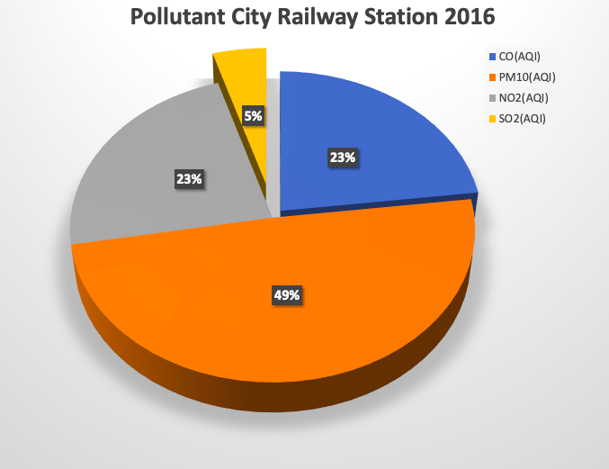
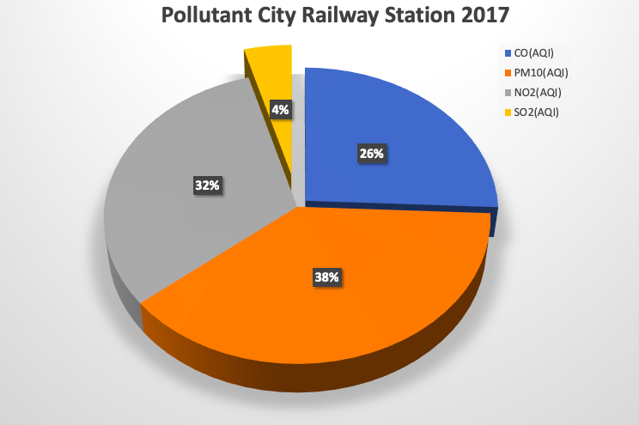
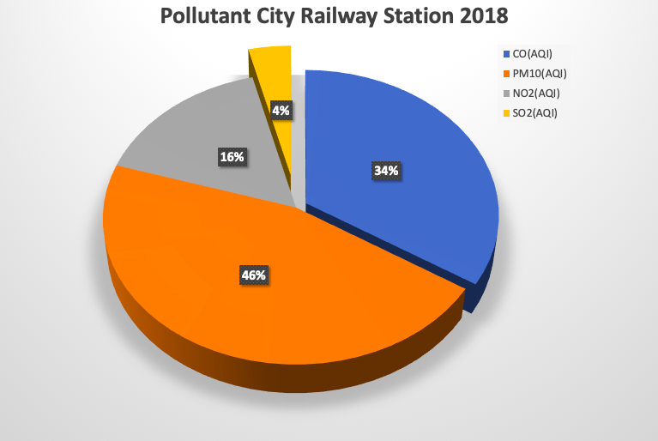

Slide 12
Statistical analysis
ARIMA(Auto Regressive Integrated Moving Average)

Slide 13
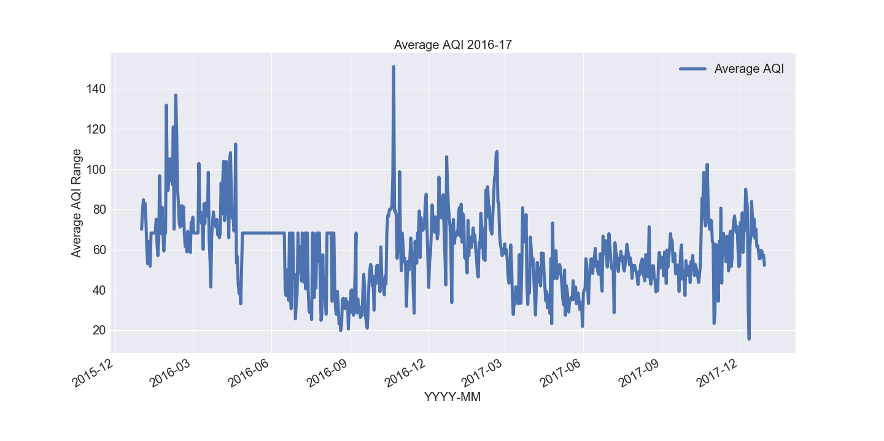

Slide 14
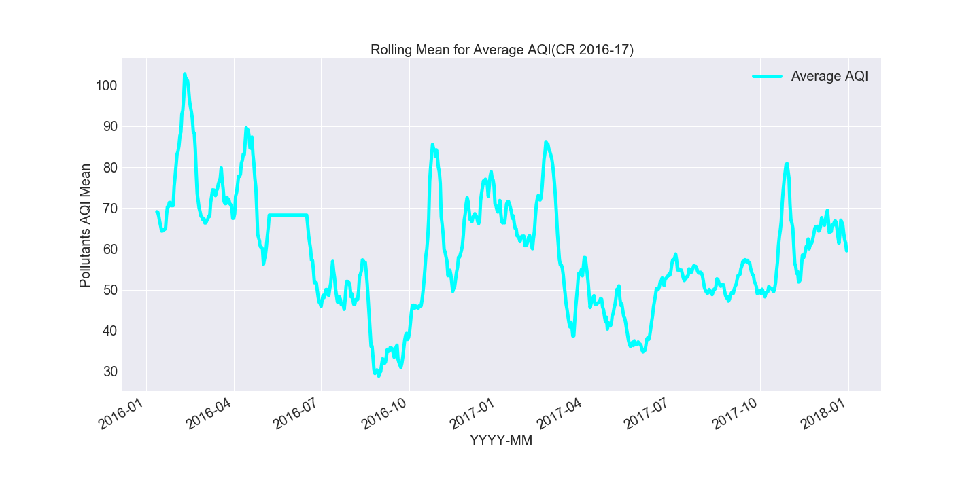

Slide 15
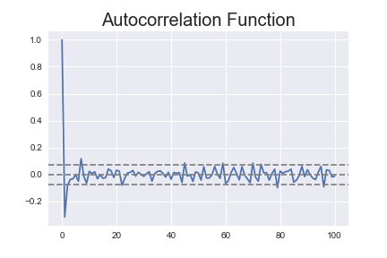
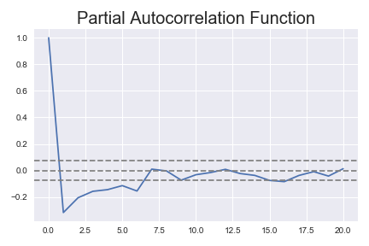

Slide 16
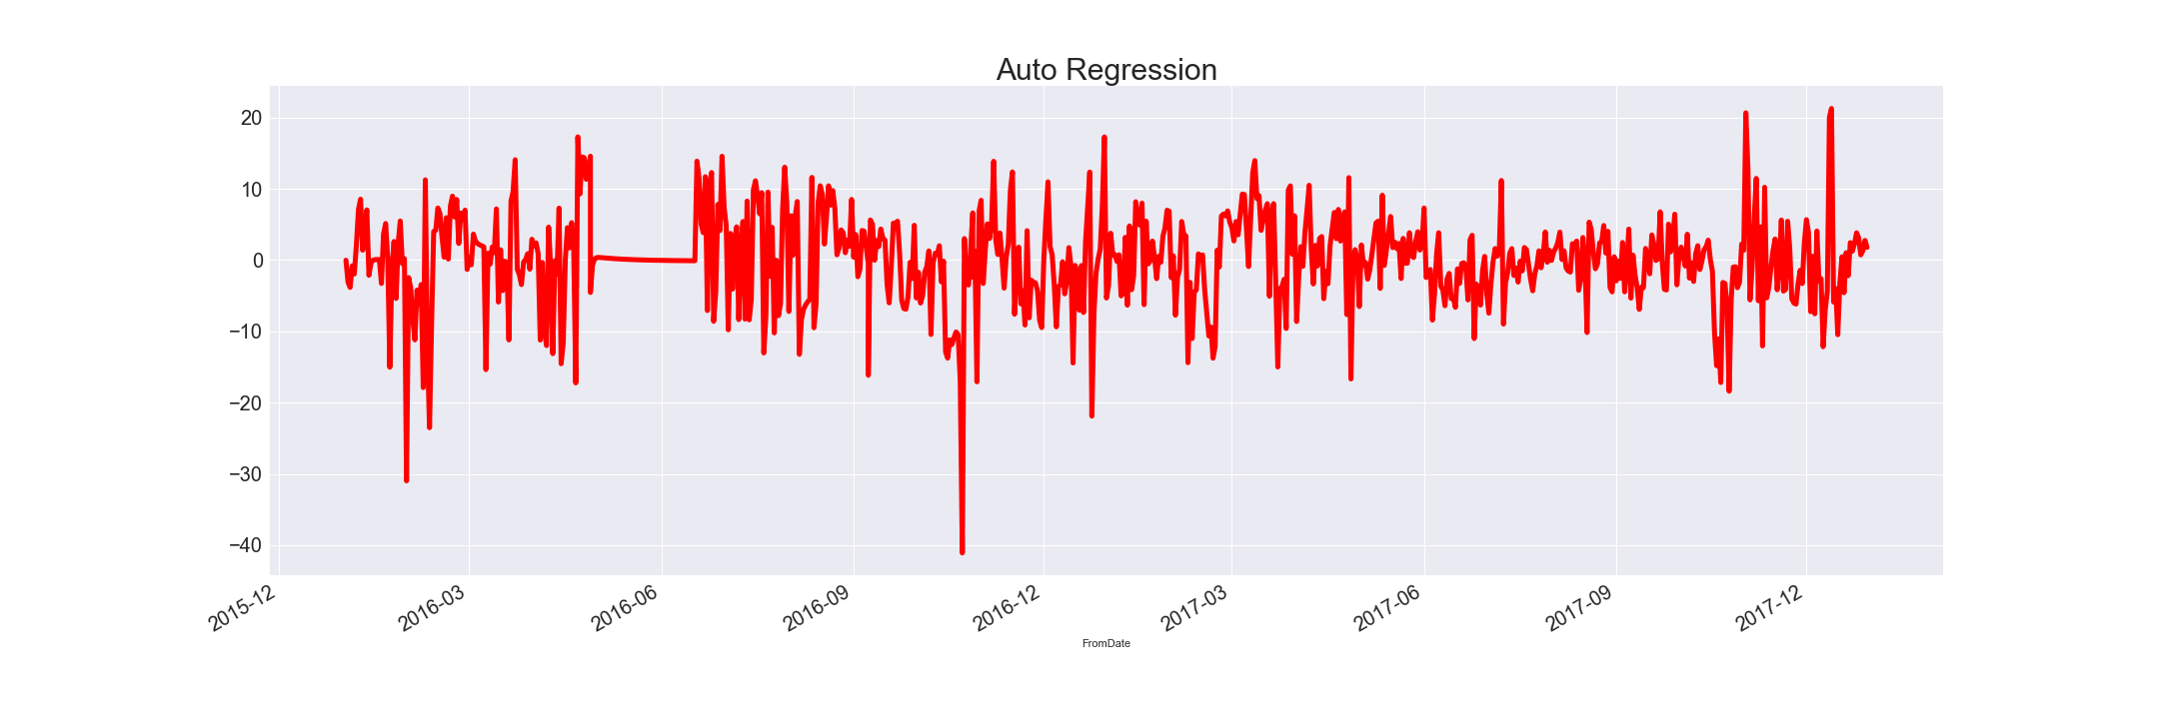
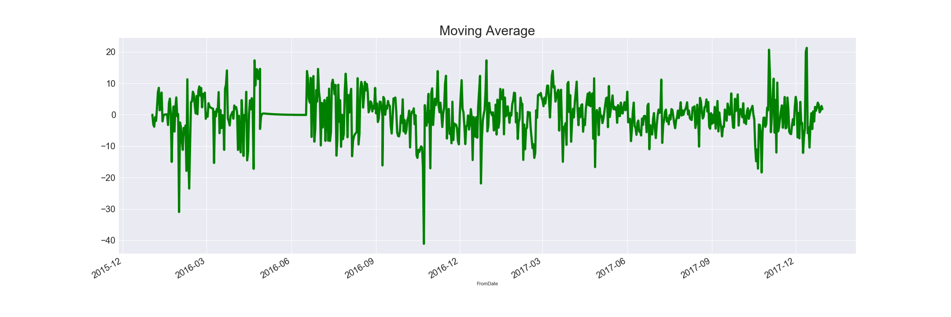

Slide 17
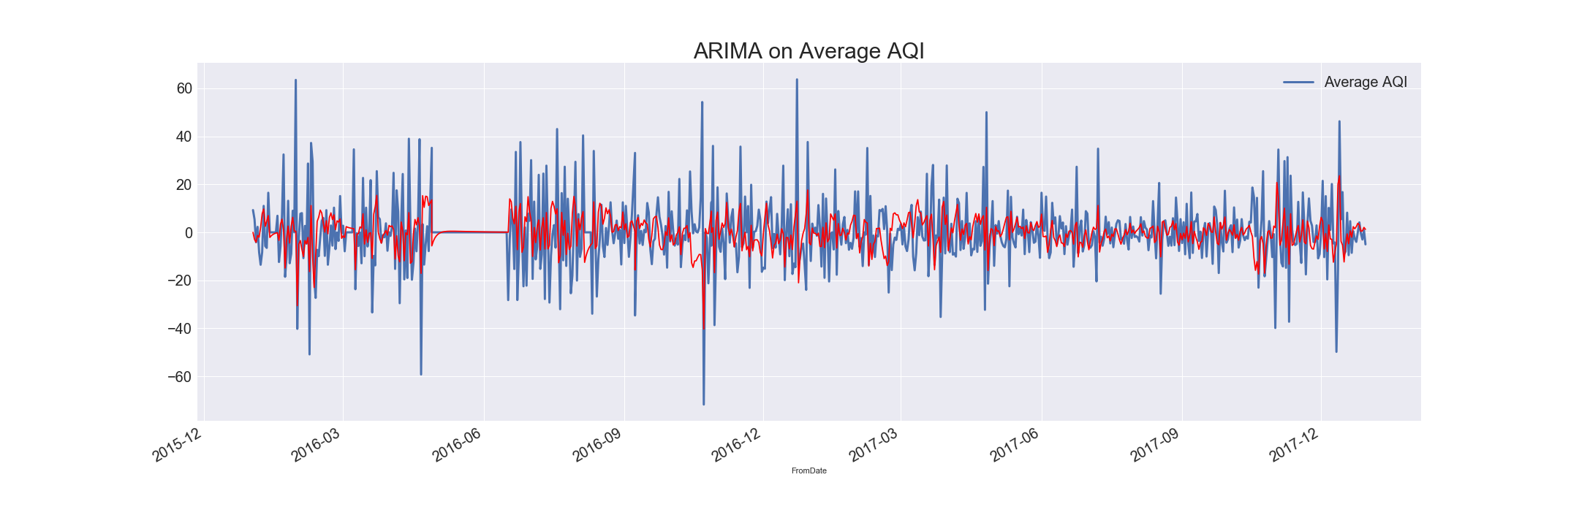

Slide 18
Interactive visualization
Range Slider
Project\All AQI and Avg.html
Project\All Pollutants.html

Slide 19
Literature review
India Air Pollution Control and Monitoring.pdf
National Air Quality Index Report.pdf
app.cpcbccr.com/ccr/#/caaqm-dashboard-all/caaqm-landing
https://en.wikipedia.org/wiki/Air_quality_index
www.analyticsvidhya.com
www.datacamp.com

Slide 20
Thank you..

